Slide 1
UNRAVELING THE CHALLENGES OF HEALTHCARE ACCESSIBILITY IN AFRICA
A detailed presentation on Analysis, Insights and Recommendations by Ajayi Toluwanimi M.

Slide 2
OUTLINE
Introduction
Project Objectives
Data Overview
Key Business Questions
Finding & Visualizations
Insights
Recommendations
Conclusion & Next Steps

Slide 3
INTRODUCTION
Why is healthcare accessibility important?
Healthcare accessibility is essential for improving health outcomes, reducing mortality rates, and ensuring timely medical interventions, especially in emergencies. It helps bridge the gap between urban and rural areas, preventing healthcare inequalities that disproportionately affect low-income and underserved communities. Accessible healthcare also strengthens economies by maintaining a productive workforce and reducing the financial burden of preventable diseases. Quality healthcare services enhance overall well-being, increasing life expectancy and improving maternal and child health. Additionally, strong healthcare systems are crucial for controlling disease outbreaks, ensuring rapid responses to pandemics and public health crises. Ultimately, healthcare accessibility is a fundamental human right that promotes social equity, economic stability, and a healthier global population.

Slide 4
PROJECT OBJECTIVES
Objectives- The objectives include:
Identify Disparities in Healthcare Access
Evaluate Healthcare Funding Efficiency
Analyze Emergency Response Systems
Develop Data-Driven Policy Recommendations
Enhance Stakeholder Decision-Making

Slide 5
DATA OVERVIEW
The Healthcare Accessibility in Africa Dataset provides insights into healthcare facility distribution, workforce capacity, funding allocation, and patient accessibility across multiple regions. The dataset helps identify disparities between urban and rural healthcare services and assess the efficiency of resource allocation.
Key Metrics
Facility Name – Unique healthcare center identifier(Region+Facility No.)
Region & Country – Location of the facility
Facility Type – Hospital, Clinic, or Health Center
Number of Doctors & Nurses – Staffing capacity per facility
Annual Patient Visits – Measure of healthcare demand
Funding Received (USD) – Financial resources allocated per facility
Emergency Response Time (mins) – Efficiency of medical services
Patient Satisfaction Rate (%) – Quality of healthcare services
Urban-Rural- Rural: Population < 5,000, Urban: Population ≥ 5,000
Dataset Size & Scope
Total Facilities: 1,998
Total Countries Covered: 10
Total Regions Covered:
Data Cleaning Summary: Duplicate facility names were removed. Text inconsistencies in Facility Name were standardized.
This dataset serves as the foundation for analyzing healthcare accessibility challenges and funding efficiency across different regions.

Slide 6
KEY BUSINESS QUESTIONS
1. How does the distribution of healthcare facilities compare between rural and urban regions?
2. Are urban healthcare facilities receiving more funding than rural ones?
3. Are healthcare facilities with higher funding more likely to have shorter emergency response times?
4. Which facility types (hospitals, clinics, health centers) show the highest efficiency in terms of funding per patient visit?

Slide 7
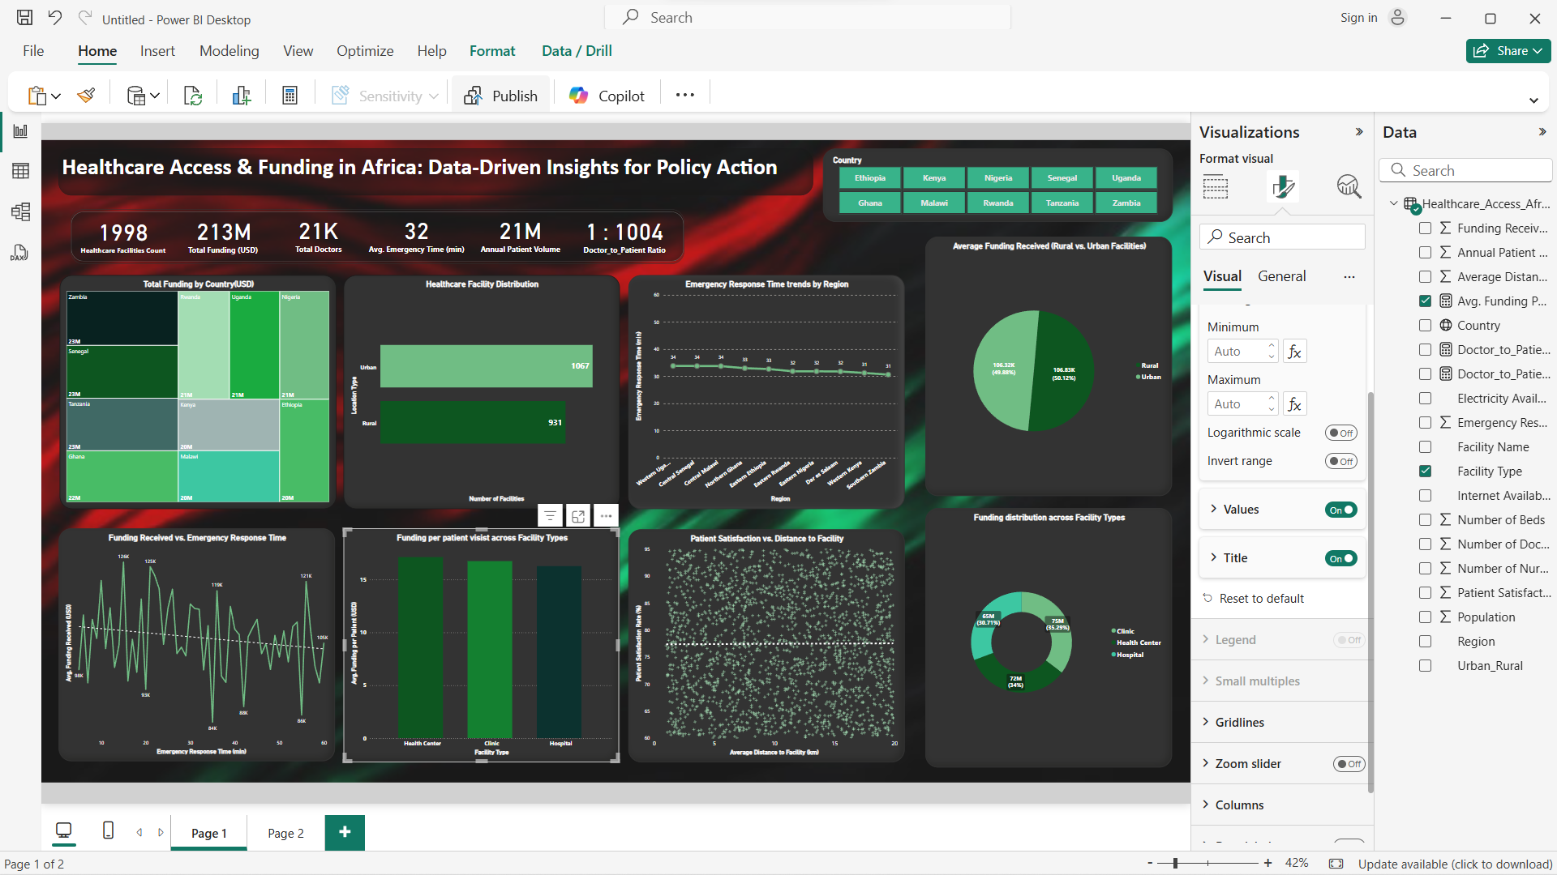
FINDINGS & VISUALIZATIONS
Urban areas have more healthcare facilities than rural areas.
There is a disparity in healthcare accessibility between rural and urban areas. More investment may be needed in rural health facilities.

Slide 8
FINDINGS & VISUALIZATIONS
Rural areas receive a larger share of funding compared to urban areas.
Urban areas get less funding despite having more healthcare facilities.

Slide 9
FINDINGS & VISUALIZATIONS
There is a fluctuating pattern in funding received concerning emergency response time.
This suggests that funding alone is not enough to improve emergency response times. Other factors, such as infrastructure and staffing, might play a role.

Slide 10
FINDINGS & VISUALIZATIONS
The average funding per patient visit is relatively consistent across Health Centers, Clinics, and Hospitals, with only slight variations. The Health Centers and Clinics appear to receive slightly more funding per patient visit compared to Hospitals. This could indicate a focus on primary healthcare facilities, which often serve as the first point of contact for patients, especially in rural areas.

Slide 11
INSIGHTS
Unequal Facility Distribution- Urban arears have a greater number of clinics and hospitals, whereas rural communities rely on fewer, often under-equipped healthcare facilities
Funding Imbalances- While rural areas receive more funding, urban regions have a higher concentration of healthcare facilities, leading to uneven resource distribution. The higher funding for rural areas suggests that policymakers are prioritizing underserved populations. This could be due to the higher operational costs of delivering healthcare in remote areas (e.g., infrastructure, logistics, and fewer healthcare professionals).
Emergency Response- Funding alone is not enough to improve emergency response times. Other factors, such as infrastructure and staffing, might play a role.
Infrastructure Gaps– Poor roads, lack of transport, and fewer healthcare professionals in rural areas lead to accessibility issues.

Slide 12
RECOMMENDATIONS
1. Optimize Healthcare Funding Allocation
Implement a data-driven funding model by distributing resources based on patient demand, disease burden, and facility workload.
Prioritize preventive care and early interventions to reduce long-term healthcare costs.
Establish performance-based funding to enhance efficiency and accountability.
Utilize real-time monitoring systems to track funding utilization and impact.
2. Expand Rural Health Infrastructure
Increase the number of clinics, mobile health units, and telemedicine services to improve access in remote areas.
Invest in better road networks and medical supply chains to enhance healthcare delivery.

Slide 13
RECOMMENDATIONS
3. Improve Emergency Response Systems
Strengthen ambulance networks and first responder training to reduce emergency response times.
Explore drone deliveries for medical supplies in hard-to-reach areas.
4. Address Healthcare Workforce Shortages
Incentivize healthcare professionals to work in rural areas by offering scholarships, housing, and career benefits.
Develop training programs to equip local healthcare workers with necessary skills.

Slide 14
RECOMMENDATIONS
5. Leverage Public-Private Partnerships
Encourage NGO and private sector investments to scale healthcare services.
Foster collaboration between governments, private entities, and international organizations to fund sustainable healthcare initiatives.

Slide 15
CONCLUSION
This project has identified significant disparities in healthcare access between rural and urban areas, despite funding allocations favoring rural regions. Infrastructure challenges, workforce shortages, and emergency response delays remain key barriers to equitable healthcare delivery.
To bridge these gaps, a data-driven approach is essential in optimizing resource allocation and improving healthcare efficiency. Addressing these disparities will require targeted investments, better emergency response systems, and stronger healthcare workforce support.
By leveraging these insights, policymakers and stakeholders can work towards a more accessible, efficient, and equitable healthcare system for all populations.

